Slide 1
Machine Learning Operations
An Introduction
Acknowledgements: Slides adapted from Michal Maciejewski, Ryan Dawson & Arun Kumar

Slide 2


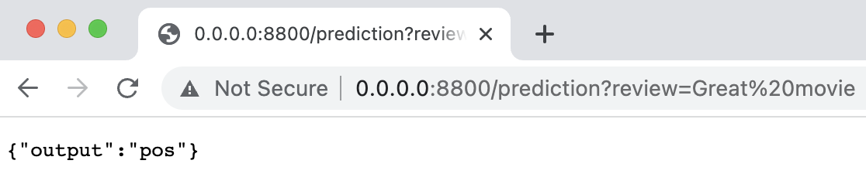
ML Model
Alice:
X
Y = f(X)
Bob:
Y = f(X)
Let’s share our model with users aka let’s put it into production!

Slide 3
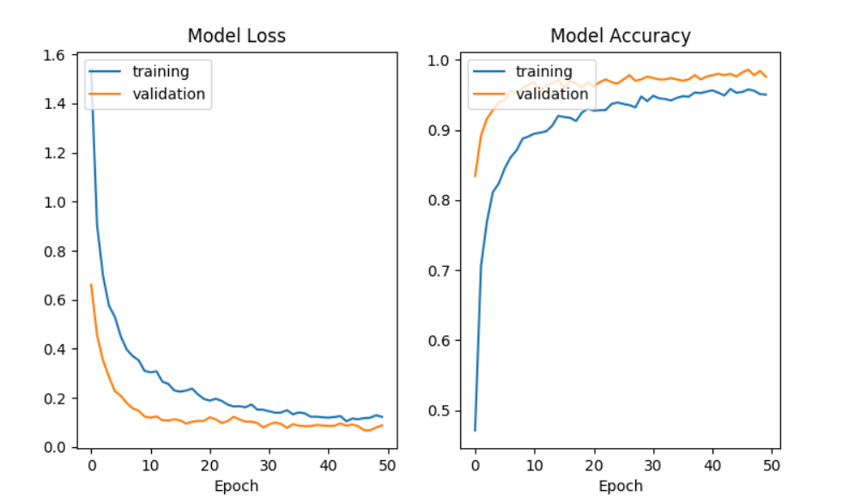
What Has to Go Right?
What is needed for an ML model to perform well in production?

Slide 4
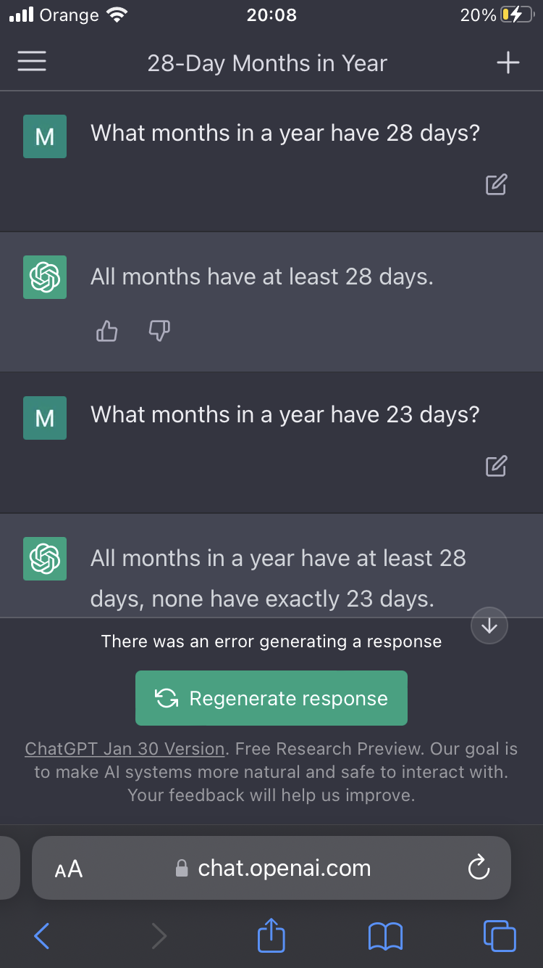
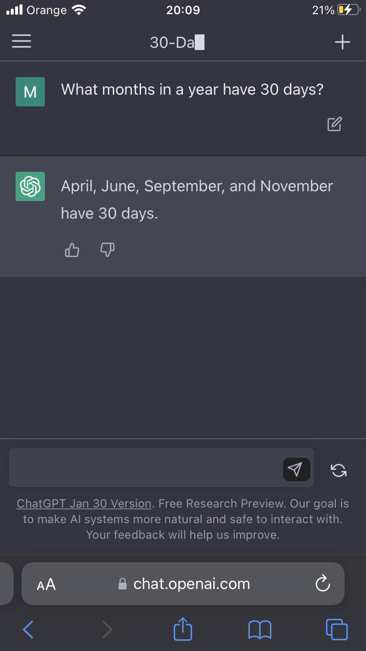
What Can Go Wrong?
Concept and data drifts are one of the main challenges of production ML systems!

Slide 5
MLOps is about maintaining the trained model performance* in production. The performance may degrade due to factors outside of our control so we ought to monitor the performance and if needed, roll out a new model to users.
*model performance = accuracy, latency, jitter, etc.

Slide 6
ML Model = Data + Code
MLOps = ML Model + Software
+ Algorithm
+ Weights
+ Hyperparameters
+ Scripts
+ Libraries
+ Infrastructure
+ DevOps

Slide 7
MLOps = ML Model + Software
Configuration
Feature Extraction
Machine Resource Management
Serving Infrastructure
Monitoring
Data Collection
ML Model
Analysis Tools
Data Verification
Process Management Tools
ML Framework
Your code
Good news: most of these components come as ready-to-use frameworks
D. Sculley et. al. Hidden Technical Debt in Machine Learning Systems, NIPS 2015

Slide 8
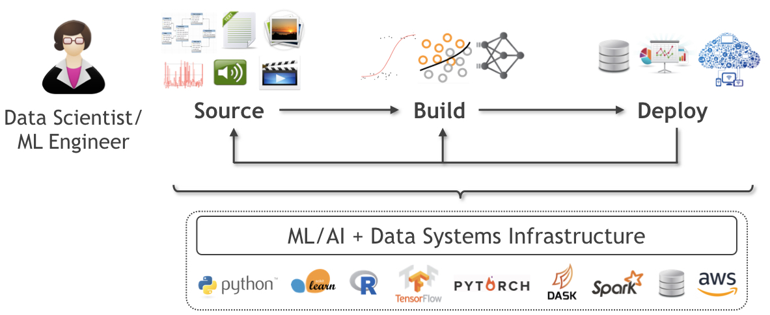
ML Platforms in the Lifecycle
Feature Engineering
Training & Inference
Model Selection
Data acquisition
Data preparation
Serving
Monitoring

Slide 9
MLOps = ML Model + Software
Q: What sort of “debts” arise in real-world ML and why?

Slide 10
Technical Debt in ML Applications
Q: What sort of “debts” arise in real-world ML and why?
Debt: Creeping complexity in software management due to insidious errors, failures; reduces productivity; raises costs
ML applications face new sources (vs deterministic software) of debt:
Datasets
Data preparation & featurization codes
Auxiliary configurations
Cross-tool/Language dependencies
Concept evolution or drift

Slide 11
Debt Source 1: Datasets
ML model is a program derived from data, tested on data
This causes 4 main types of debts:
Lack of control over data sources/creators
Inherent entanglement of features
Lack of control over prediction consumers
Scale-related errors
Potential mitigation approaches:
Mutually intelligible versioning of data and ML
Refactor sources by importance
Authentication and control of API usage
Test for deployment scale

Slide 12
Debt Source 2: Data preparation & featurization
Raw data is seldom used as such in Machine Learning
This causes 3 main types of debts:
Pipeline jungles
Unstable and Inconsistent prep/featurization
Wasteful retention of non-useful features
Potential mitigation approaches:
API-based preparation & featurization frameworks
Versioning of preparation & featurization codes
Refactor feature use by importance

Slide 13
Debt Source 3: Auxiliary Configs
Configs are ubiquitous in ML (code, training, prediction)
This causes 3 main types of debts:
Manual config management; forgotten configs
Wrong config values; Silent failures
Dead experimentation code paths
Potential mitigation approaches:
API-based config management
Automated tests/analyses to vet configs
Automated experimentation/metadata handling

Slide 14
Debt Source 4: Cross Dependencies
End-to-end ML workflows often straddle multiple tools/PLs
This causes 2 main types of debts:
Glue code
Abstraction debt
Potential mitigation approaches:
Encapsulation with multiple levels of APIs
Standardize execution engines/frameworks

Slide 15
Debt Source 5: Concept Evolution
ML is coupled to application’s underlying concept/distribution
This causes 2 main types of debts:
Concept drift
Feedback loops
Potential mitigation approaches:
Monitoring and actionable recourse
Organization-wide A/B test controls

Slide 16
Introducing ML Platforms
Goal: Pay off technical debt of modern ML systems
No consensus yet on “canonical” architecture but 3 things:
End-to-end governance: access control, versioning, usage control, deployment support, monitoring
Share components across apps/ users; less glue code, more code reuse, more automation
Standardization of APIs for data, features, ML code, configs; lower abstraction debt, fewer pipeline jungles, less manual handling/errors

Slide 17
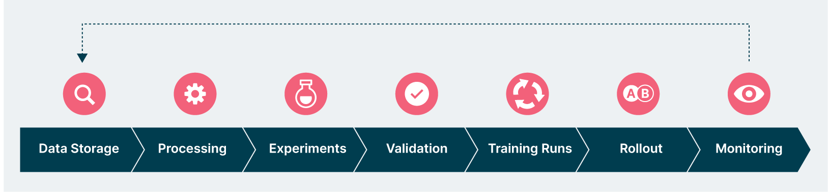
Revisit the ML Workflow: High Level
Data Storage: Raw data to build model from.
Processing: Cleaning and feature extraction.
Experiments: Figuring out which models might work.
Validation: Checking the models.
Training Runs: Build model with more data.
Rollout: Take to prod.
Monitoring: Ensure it keeps working.
Notes:
MLOps is about supporting the ML lifecycle - the flow from deciding to build a model to getting value from it in live. Here’s a breakdown of the ML lifecycle. We start with taking data from storage, cleaning it and extracting features, running experiments to put together a model that might work, validating that model, making it more robust by adding more data, rolling it out to production and making sure it keeps working - or at least that you find out about it if it stops working. This is all a bit abstract so let’s walk through a toy example to see what it means.

Slide 18
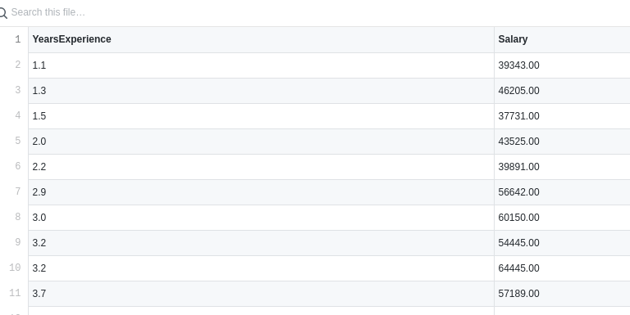

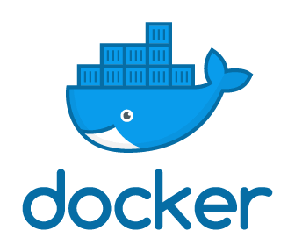
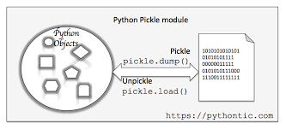





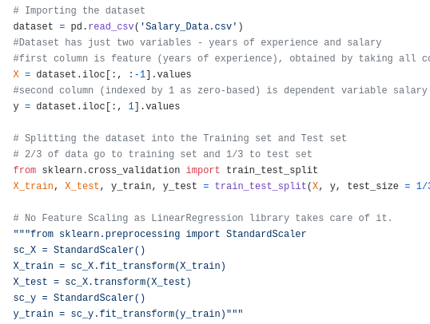

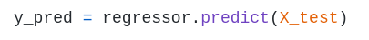









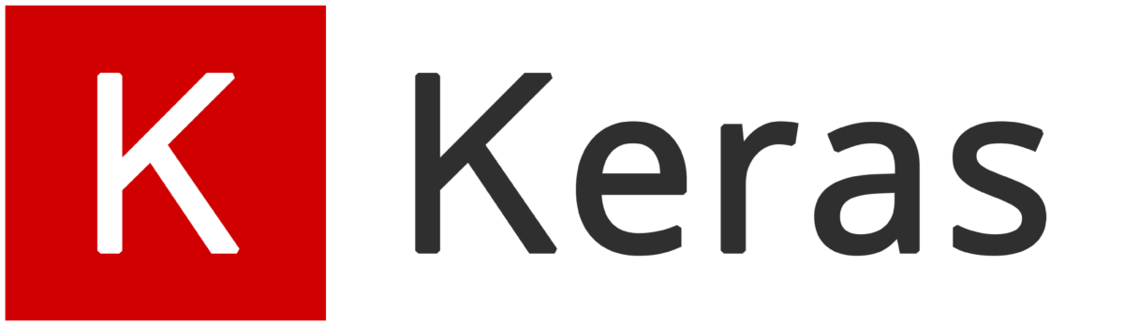



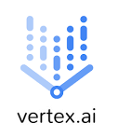
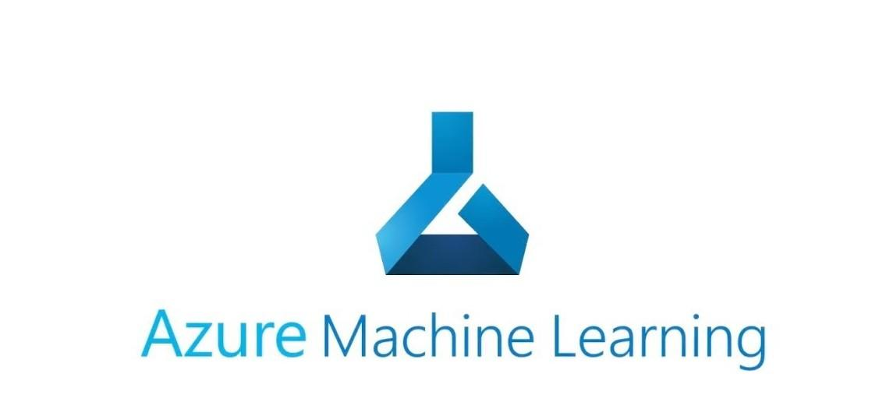
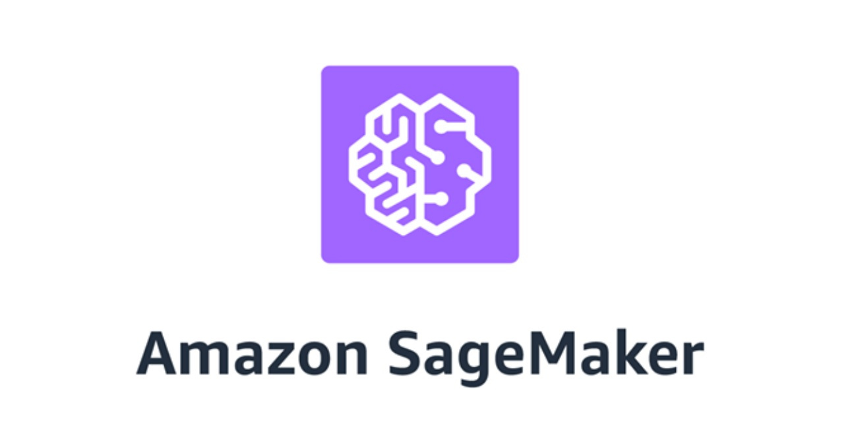



ML Worflow: Detailed
Data Science Question
Can we estimate/set/benchmark employee pay from this data?
Data
Serving
Training
Package
Training
Batch
Prediction
Tracking
Frameworks
E2E
Notes:
Let’s go through an ML Workfow in detail to really get a flavour of what MLOps is all about. We’ll start with some data and a question. Let’s say we’ve got data employees and their experience and skills and salaries we want to see whether we could use it benchmark salaries for other employees during a pay review. Let’s assume the data is already available and clean, though this is a pretty big assumption. But let’s assume we’ve got good data and we can create a regression model that maps employee experience to pay, maybe using scikit-learn. So we train the model and then it can be used to make a prediction for any given employee, what the salary benchmark would be. Let’s say we give our predictions for a particular set of employees to the business and they’re happy with that. So happy that they want to use it again next year or more regularly. Then our situation changes because then what we want isn’t just a prediction but a predict function. We want a predict function because we don’t want to have to re-run the training process every time the business have some new employees to check. This problem would be magnified if another department says that they want predictions too. Actually that would add extra complication as even if we know that the patterns from our training data are applicable to our department, we don’t necessarily know about the new department. But let’s assume that the data is applicable. Then our main problem is a problem of scaling - how do we make all these predictions without burning ourselves out? Probably we’re going to be interested in using the machine learning model in a web app. So maybe we add a REST API around our python code and look to run it as a web application. We might naturally package it in a docker container like we would for a traditional web app. This is a valid and common approach but it’s just one approach with machine learning deployment. It’s also common to separate model from the data by taking the python variable for the model predictor and serializing that to a file using python pickling. Then the file can be loaded into another running python application. So if we load the model into a suitable python web server app then we can serve predictions that way. This varies a little from framework to framework and can vary quite a lot if the language is not python. But basically this is a good picture for the machine learning cycle - get data, clean it, experiment with it, train a model, package the model into something that can serve predictions. And there are tools pitched at each stage of this cycle. For data storage and prep there’s tools like S3 and hadoop. Training can use a lot of compute resource and take a long time so there’s tools that help with running long-running training jobs. There’s also tools for tracking all the operations performed during training. There are tools specifically aimed at helping make batch predictions on a regular cycle, say for just getting predictions every month or whatever the cycle is that the business work to. Or if the predictions could be needed at any time then there’s tools for serving real-time predictions using a REST API. This slide only has a very small sample of the tools available in all these spaces and there are even spaces I’ve not covered here such as monitoring. So you might naturally wonder - can’t I avoid dealing with all these tools and get everything from one end-to-end platform? Platforms can save you the effort of stitching several different tools together but platforms can also be opinionated so they don’t necessarily fit every use case.

Slide 19

Why an MLOps Platform?
Reduce tool overload
Make a baseline on ML projects easier to achieve
Avoid a ‘zoo’
Ensure skills are portable
Reduce maintenance at tooling/infra level
Out of the box integrations between stages
Centralized permissions/governance
A big overriding factor is your org’s cloud/infra strategy
Notes:
So why a platform? Why not just pick tools for individual projects as they come up? Well, there’s a lot of tools out there and choosing them can be confusing. With a platform in place, projects can skip that decision stage and start using it. This can save time on new projects and also make it easier for people to move between existing projects. When it comes to keeping versions up to date, it’s easier to see what every project is using and what upgrades need to be done. There’s also the advantage that the parts of a platform should already be integrated together, whereas a patchwork of tools requires integration work. For example, the permissions and governance features of tools might not be neatly integrated so with a patchwork you might end up managing that across different places. This is not just benefits of off-the-shelf platforms. You can certainly stitch tools together into your own platform and then these benefits can apply for the projects using it.

Slide 20
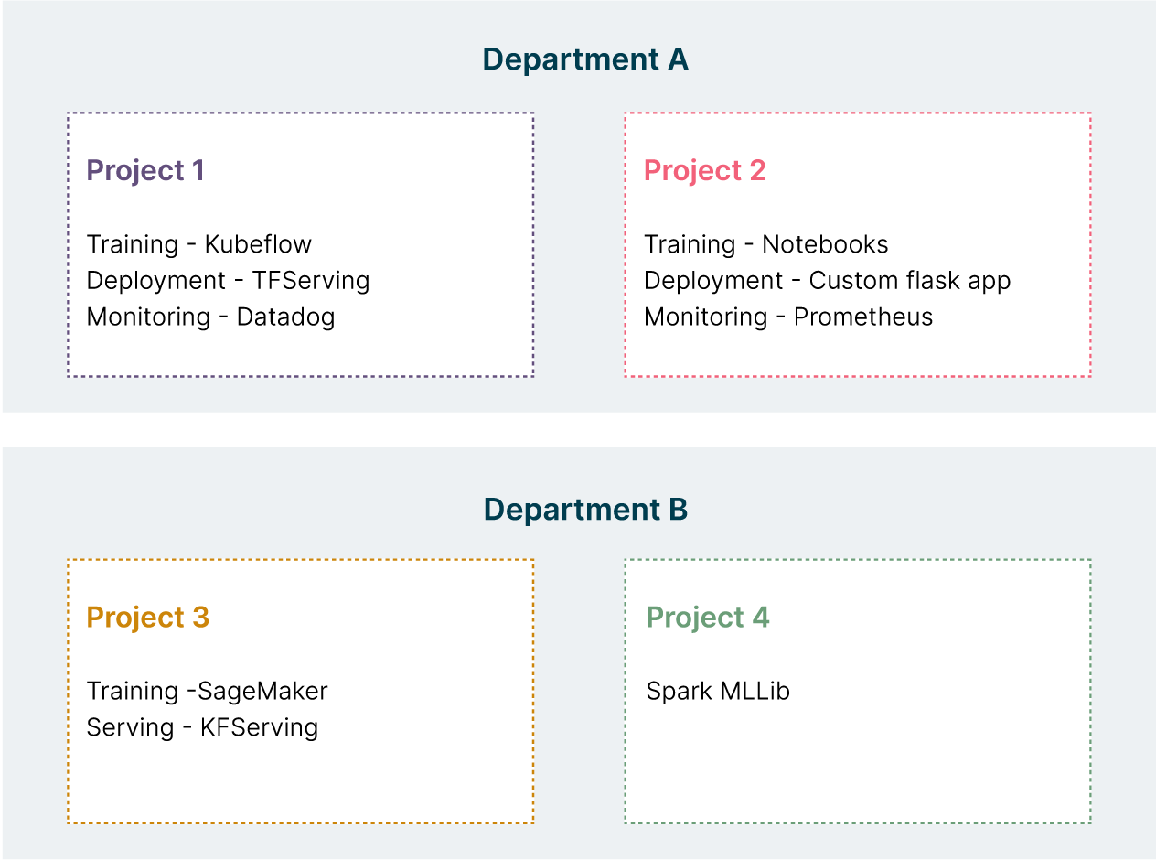
Avoiding a ‘zoo’
Easy to end up with huge variation of tools across org.
This diagram simplifies - imagine more departments and projects.
Notes:
If you don’t consciously choose a platform then you might find different projects all make different decisions. This is what this slide is illustrating - a ‘zoo’ of different tools for different projects. It’s a ‘zoo’ because in a zoo you have lots of different animals next to each other. This can happen very easily and what the slide illustrates isn’t actually all that much variation - it’s easier to get much more than this at a big organization where you’ve got more project and departments. Here you can see that the skills required to work on and maintain project 4, for example, are very different from the skills for project 1.

Slide 21
A Simplified MLOps Pipeline
Data Engineering
Modelling
Deployment
Monitoring
MLOps is a multi-stage, iterative process.

Slide 22
Data Engineering
Reproducibility
Traceability
Data-driven ML
Data Engineering
Modelling
Deployment
Monitoring

Slide 23

f( )
=

Slide 24
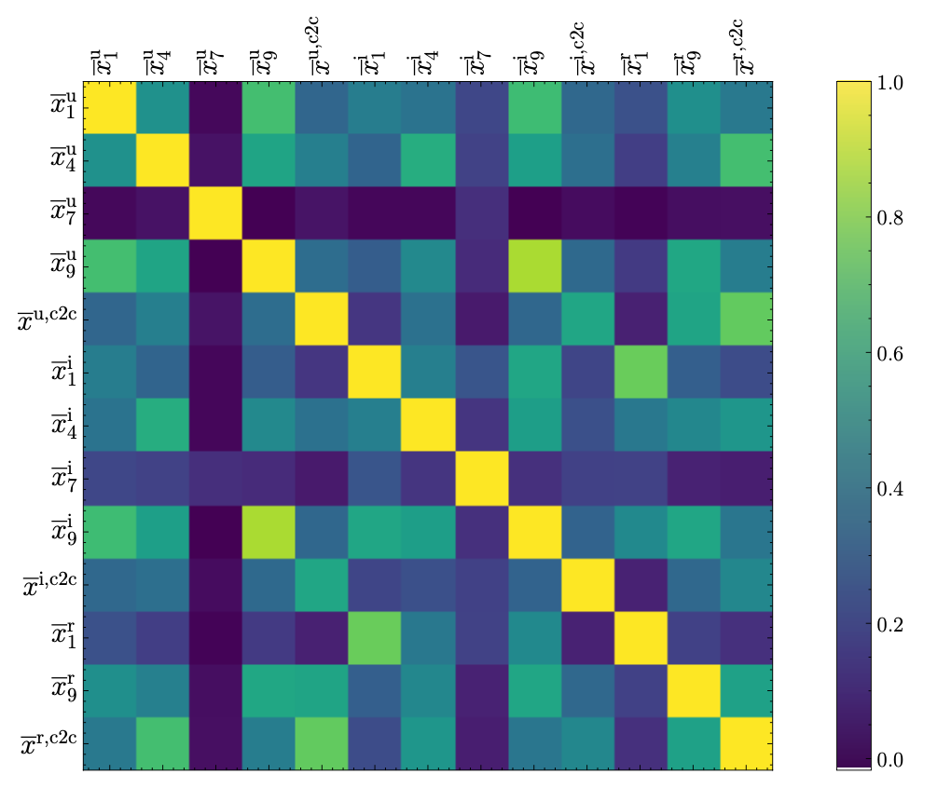
Exploratory Data Analysis
For structured data:
schema as required tables, columns and datatypes
For unstructured data:
resolution, image extension
frequency, duration, audio codec
Initial exploration allows indetifying requirements for input data in produciton.

Slide 25
Data Processing Pipeline
Data Ingestion
Data Validation
Data Cleaning
Feature Engineering
Load from file
Load from db
Schema check
Audio/video file check
Filling NaNs
Filtering
Normalization
Standarization
Feature selection
Feature crossover
We need to reproduce some of those steps (e.g. subtracting mean) in production!

Slide 26


Reproducibility
Dataset
Excel spreadsheets
Notebooks
Various scripts
Curated dataset
https://sites.google.com/princeton.edu/rep-workshop/

Slide 27
Keeping Track of Data Processing
Version Input Data – DVC framework
Version Processing Script - GitLab
Version Computing Environment - Docker
Data Provenance – where does data come from?
Data Lineage – how data is manipulated?

Slide 28
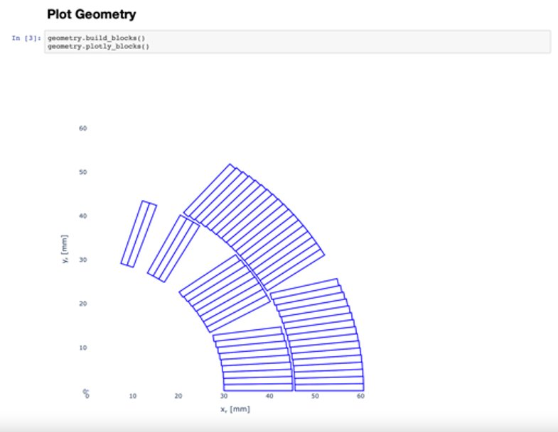
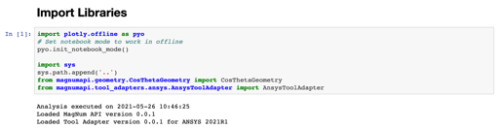
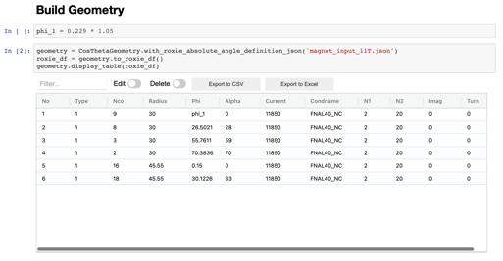

Notebook Good Practices
Linear flow of execution
Little amount of code
Extract reusable code into a package
Pre-commit for cleaning notebook before committing to a repository
Set parameters on top so that notebook can be treated as a function (papermill and scrapbook packages)
It is OK, to do exploratory quick&dirty model development.
Once we start communicating the model outside, we need to clean it!

Slide 29
From Model-driven to Data-driven ML
 | Model-driven ML | Data-driven ML
Fixed component | Dataset | Model Architecture
Variable component | Model Architecture | Dataset
Objective | High accuracy | Fairness, low bias
Explainability | Limited | Possible
https://datacentricai.org
https://spectrum.ieee.org/andrew-ng-data-centric-ai

Slide 30
Modelling
Training challenges
Rare events
Analyzing results
Data Engineering
Modelling
Deployment
Monitoring

Slide 31
Selecting Data for Training
Dataset
Training
80%
Validation
20%
train
Hyperparameter
tuning
validate
With this approach, the model eventually sees the entire dataset.

Slide 32
Selecting Data for Training
Dataset
Training
75%
Validation
15%
Test
10%
Final
check
train
Hyperparameter
tuning
validate
test
Splitting dataset in three allows to perform a final check with unseen data.

Slide 33
Balancing Datasets
Consider a binary classification problem with a dataset composed of 200 entries.
There are 160 negative examples (no failure) and 40 positive ones (failure).
Training
75% (120 + 30)
Validation
15% (24+6)
Test
10%
(16+4)
Expected:
Training
75% (131 + 19)
Validation
15% (19+11)
Test
10%
(10+10)
Random:
For continuous values it is important to preserve statistical distribution.
Although for big datasets it is not an issue, it is still a low-hanging-fruit.

Slide 34
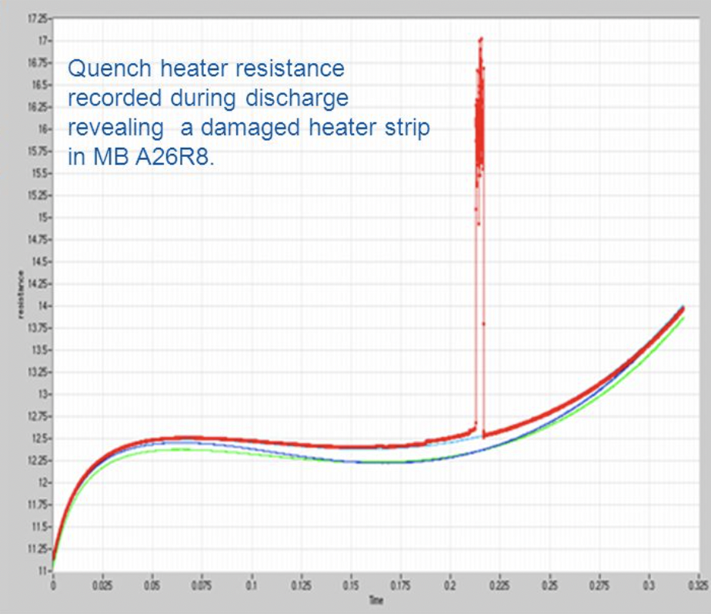
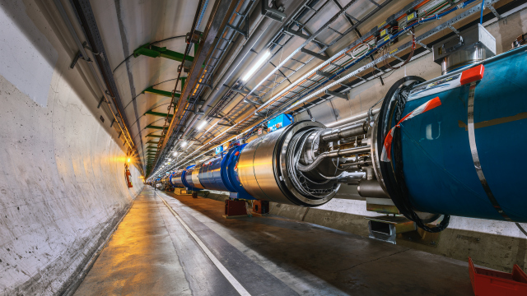
Rare Events
There were 3130 healthy signals (Y=False) and 112 faulty ones (Y=True)
C. Obermair, Extension of Signal Monitoring Applications with Machine Learning, Master Thesis, TU Graz
M. Brice, LHC tunnel Pictures during LS2, https://cds.cern.ch/images/CERN-PHOTO-201904-108-15

Slide 35
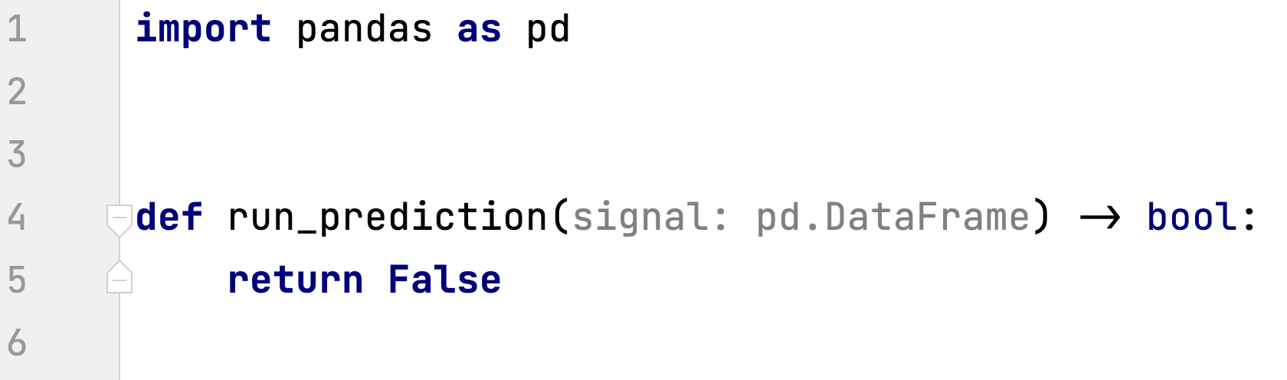
Rare Events
This naive model is guaranteed to achieve 97% average dataset accuracy?!

Slide 36
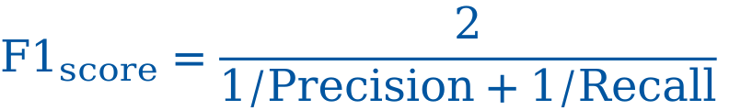
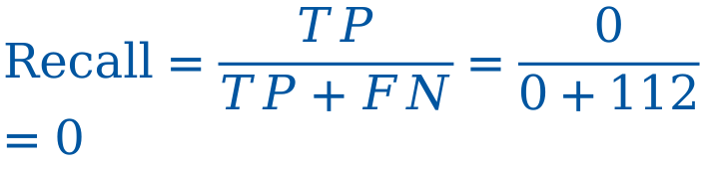
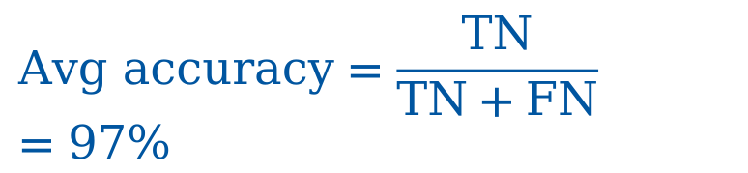
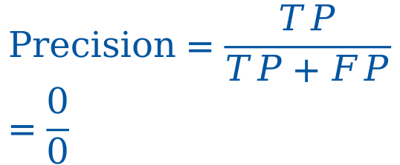
Rare Events
 |  | Ground truth
 |  | Y = True | Y = False
Model | Y = True | 0 true positive | 0 false positive
 | Y = False | 112 false negative | 3130 true negative
$$Avg accuracy=\frac{TN}{TN+FN}=97\%$$
$$Precision=\frac{TP}{TP+FP}=\frac{0}{0}$$
$$Recall=\frac{TP}{TP+FN}=\frac{0}{0+112}=0$$
$$F1_{score}=\frac{2}{1/Precision+1/Recall}$$
It is a valuable conversation to decide if precision or recall (or both) is more important.
Notes:
When one of the values of Y is rare in the population, considerable resources in datacollection can be saved by randomly selecting within categories of Y. This is known in
econometrics as choice-based or endogenous stratified sampling and in epidemiology as a
case-control design (Breslow 1996); it is also useful for choosing qualitative case studies
(King et al. 1994, Sect. 4.4.2). The strategy is to select on Y
by collecting observations
(randomly or all those available) for which Y
= 1 (the "cases") and a random selection of
observations for which Y = 0 (the "controls").

Slide 37
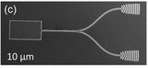
Data Augmentation
New examples obtained by
shifting the region left and right
New examples obtained by
rotating/shifting/hiding
JH. Kim et al. Hybrid Integration of Solid-State Quantum Emitters on a Silicon Photonic Chip, Nano Letters 2017

Slide 38
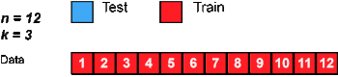
What else can we do?
When one of the values of Y is rare in the population, considerable resources in data collection can be saved by randomly selecting within categories of Y. […]
The strategy is to select on Y by collecting observations (randomly or all those available) for which Y = 1 (the "cases") and a random selection of observations for which Y = 0 (the "controls").
We can also collect more data of particular class (if even possible).
G. King and L. Zeng, “Logistic Regression in Rare Events Data,” Political Analysis, p. 28, 2001.
https://en.wikipedia.org/wiki/Cross-validation_(statistics)

Slide 39




Training Tracking
Pen & Paper
Spreadsheet
Dedicated framework
Weights and Biases
MLFlow
Neptune.ai
Tensorflow Extended (TFX)
…

Slide 40
Error Analysis
# | Signal | Noise | Gap in signal | Bias | Wrong sampling
1 | Magnet 1 | x | x
2 | Magnet 2 |  |  | x | x
3 | Magnet 3 | x | x
Such analysis may reveal issues with labelling or rare classes in data.
For unstructured data, a cockpit could help in analysis.
Useful in monitoring of certain classes of inputs.

Slide 41
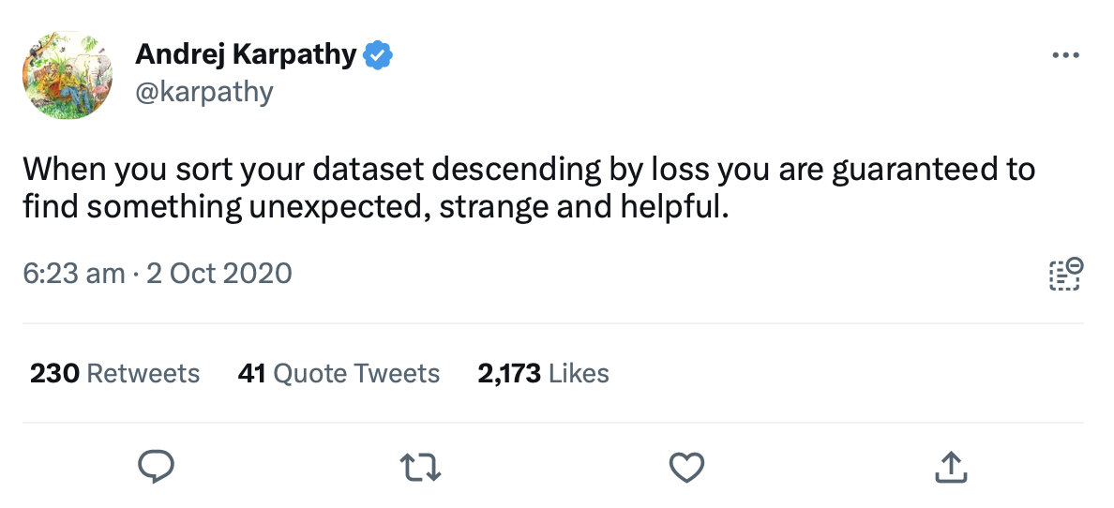

Slide 42
Deployment
Degrees of automation
Modes of deployment
Reproducible environments
Data Engineering
Modelling
Deployment
Monitoring

Slide 43
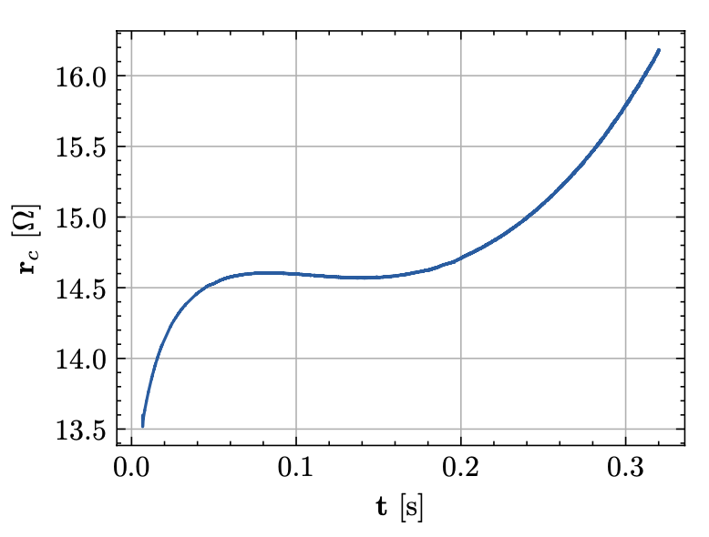
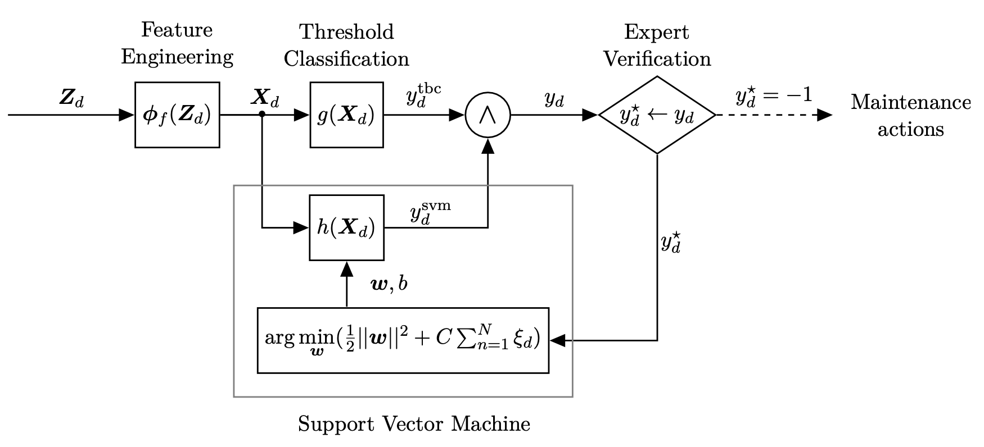
Degrees of Automation
Human inspection
Shadow mode
Human in the loop
Full Automation
Starting from Shadow mode we can collect more training data in production!
C. Obermair, Extension of Signal Monitoring Applications with Machine Learning, Master Thesis, TU Graz

Slide 44

Modes of Deployment
Old version
100-X%
Router
X%
New version
In Canary deployment there is a gradual switch between versions
In Blue/green deployment there is an on/off switch between versions
https://hbr.org/2017/09/the-surprising-power-of-online-experiments
https://en.wikipedia.org/wiki/Blue-winged_parrot

Slide 45

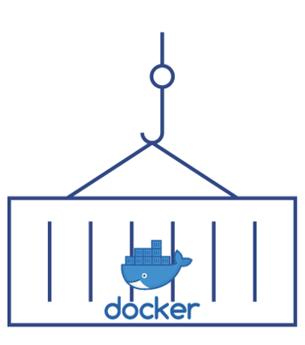



Reproducible Environments
Request
Response
Request
Response
Computing environment (OS, Python, packages)
HTTP Server
KServe
REST API
Data Pipeline
Config
file
Pool of
models
Computing infrastructure
ML Model
Docker Containers
Serverless compute
We will play with those during the exercise sessions!

Slide 46
Monitoring
Useful metrics
Relevant frameworks
Data Engineering
Modelling
Deployment
Monitoring

Slide 47
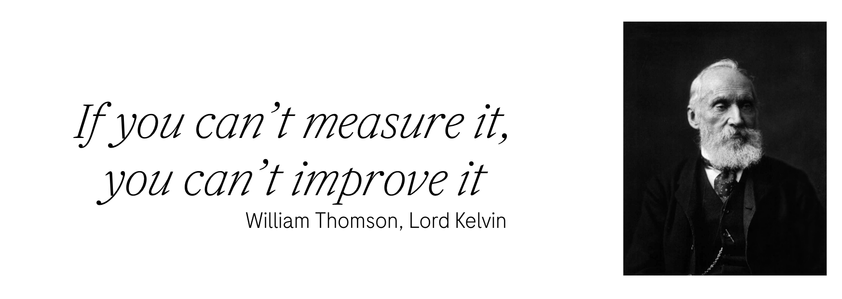

Slide 48
Relevant Metrics
Model metrics
Distribution of input features – data/concept drift
Missing/malformed values in the input
Average output accuracy/classification distribution – concept drift
Infrastructure metrics
Logging errors
Memory, CPU resources utilization
Latency and jitter
For each of the relevant metrics one should define warning/error thresholds.

Slide 49
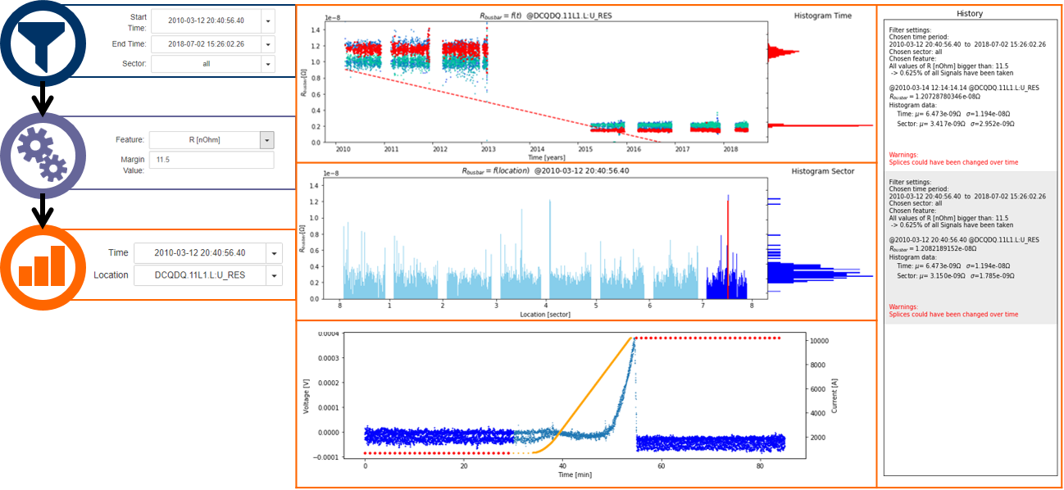
Monitoring Matters
C. Obermair, Extension of Signal Monitoring Applications with Machine Learning, Master Thesis, TU Graz

Slide 50

Data Engineering
Modelling
Deployment
Monitoring

Slide 51
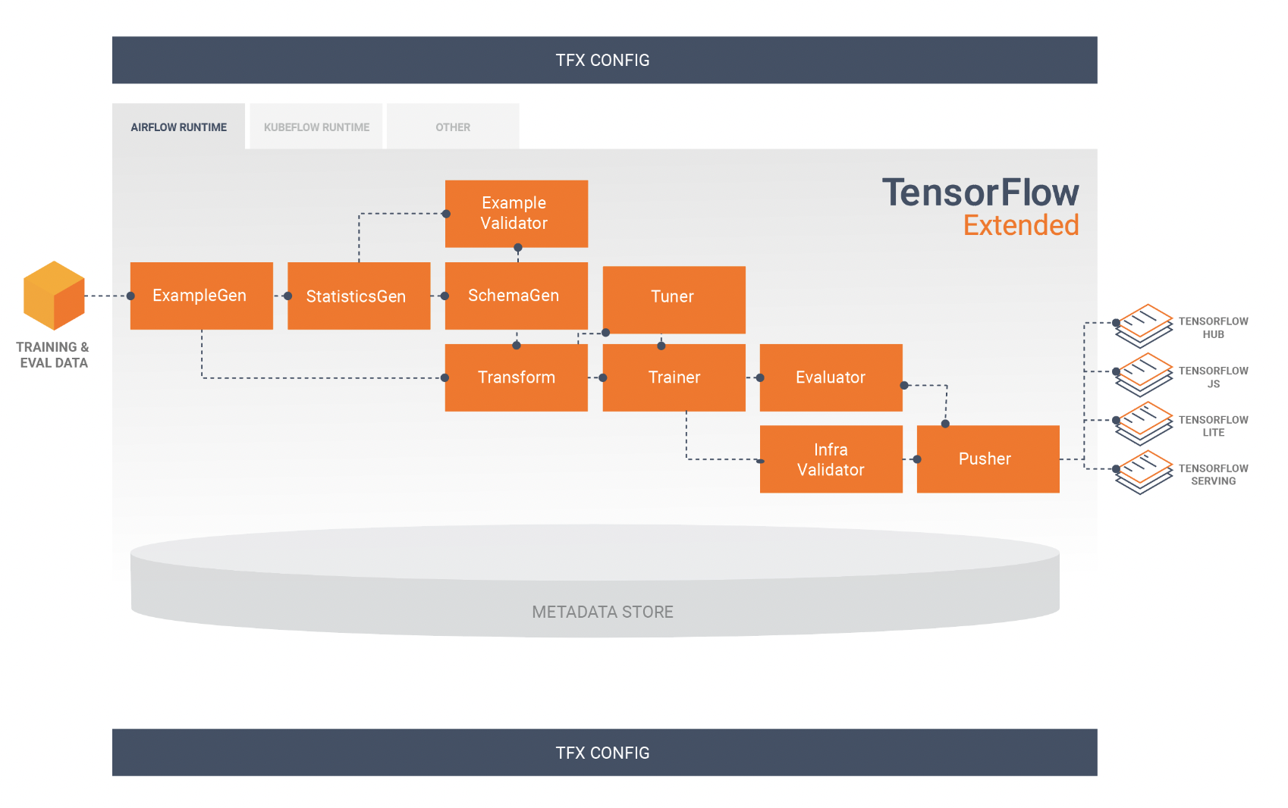
MLOps Pipeline with Tensorflow
Pipeline represented as DAG directed acyclic graph
Data Engineering
Modelling
Deployment
https://www.tensorflow.org/tfx/guide

Slide 52
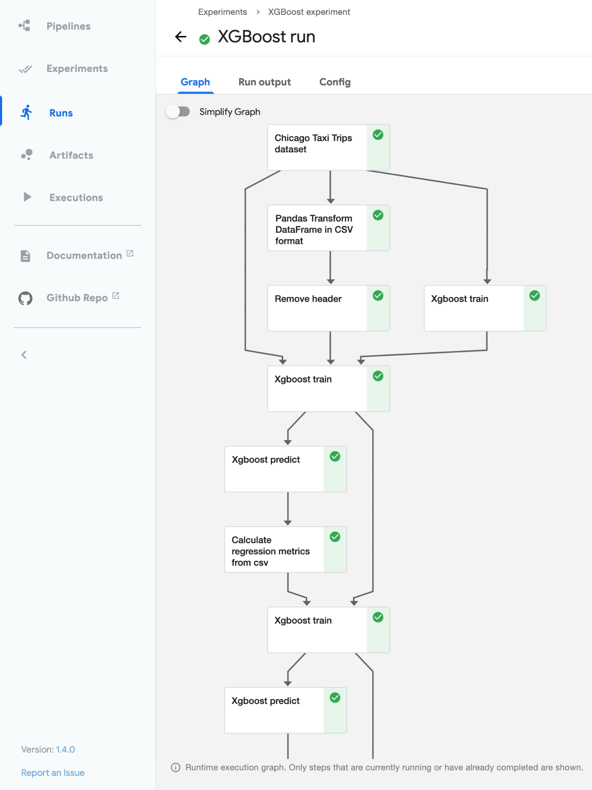
MLOps Pipeline with Kubeflow
Data Engineering
Modelling
https://ml.cern.ch
https://www.kubeflow.org/docs/started/
Deployment
Notes:
Load balancer for computation

Slide 53
Conclusion
 | Development ML | Production ML
Objective | High-accuracy model | Efficiency of the overall system
Dataset | Fixed | Evolving
Code quality | Secondary importance | Critical
Model training | Optimal tuning | Fast turn-arounds
Reproducibility | Secondary importance | Critical
Traceability | Secondary importance | Critical

Slide 54
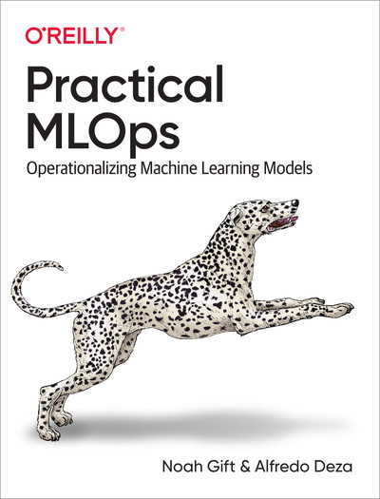
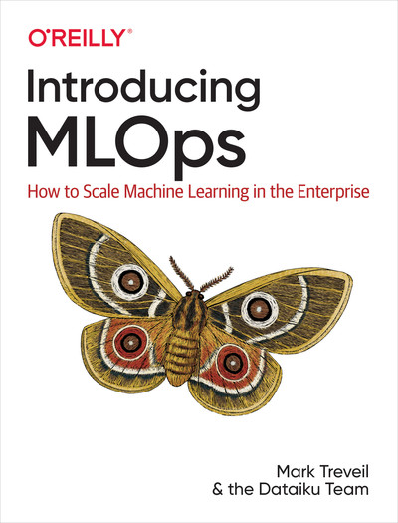

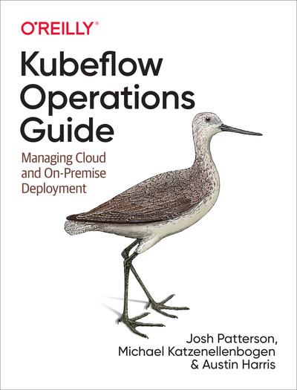


Resources
Machine Learning Engineering for Production (MLOps) Specialization

